Slide 1
Optimizing HR Recruitment for Big Data Roles: A Data-driven approach
Lakshmi Prasanna Peddi
Sai Sree Gajjala
Pravallika Peddi
Vineela Kolagani

Slide 2
Introduction
The use of the power of big data analytics is crucial in the dynamic world of recruitment, where businesses are constantly looking for highly talented individuals to promote their success. Our project, "Optimized Recruitment," sets out to innovate conventional approaches to recruiting. By delving into the vast sea of data extracted from Indeed job listings, we aim to revolutionize recruitment strategies. Our main goal is to improve business hiring processes by using advanced data analytics. The goal of our research is to help HR departments better understand and anticipate hiring trends by analyzing thousands of actual job postings.
In this presentation, we'll discuss the project's approach to the challenging landscape of HR recruitment, showing the potential of data-driven decision making to revolutionize the art of talent acquisition.

Slide 3
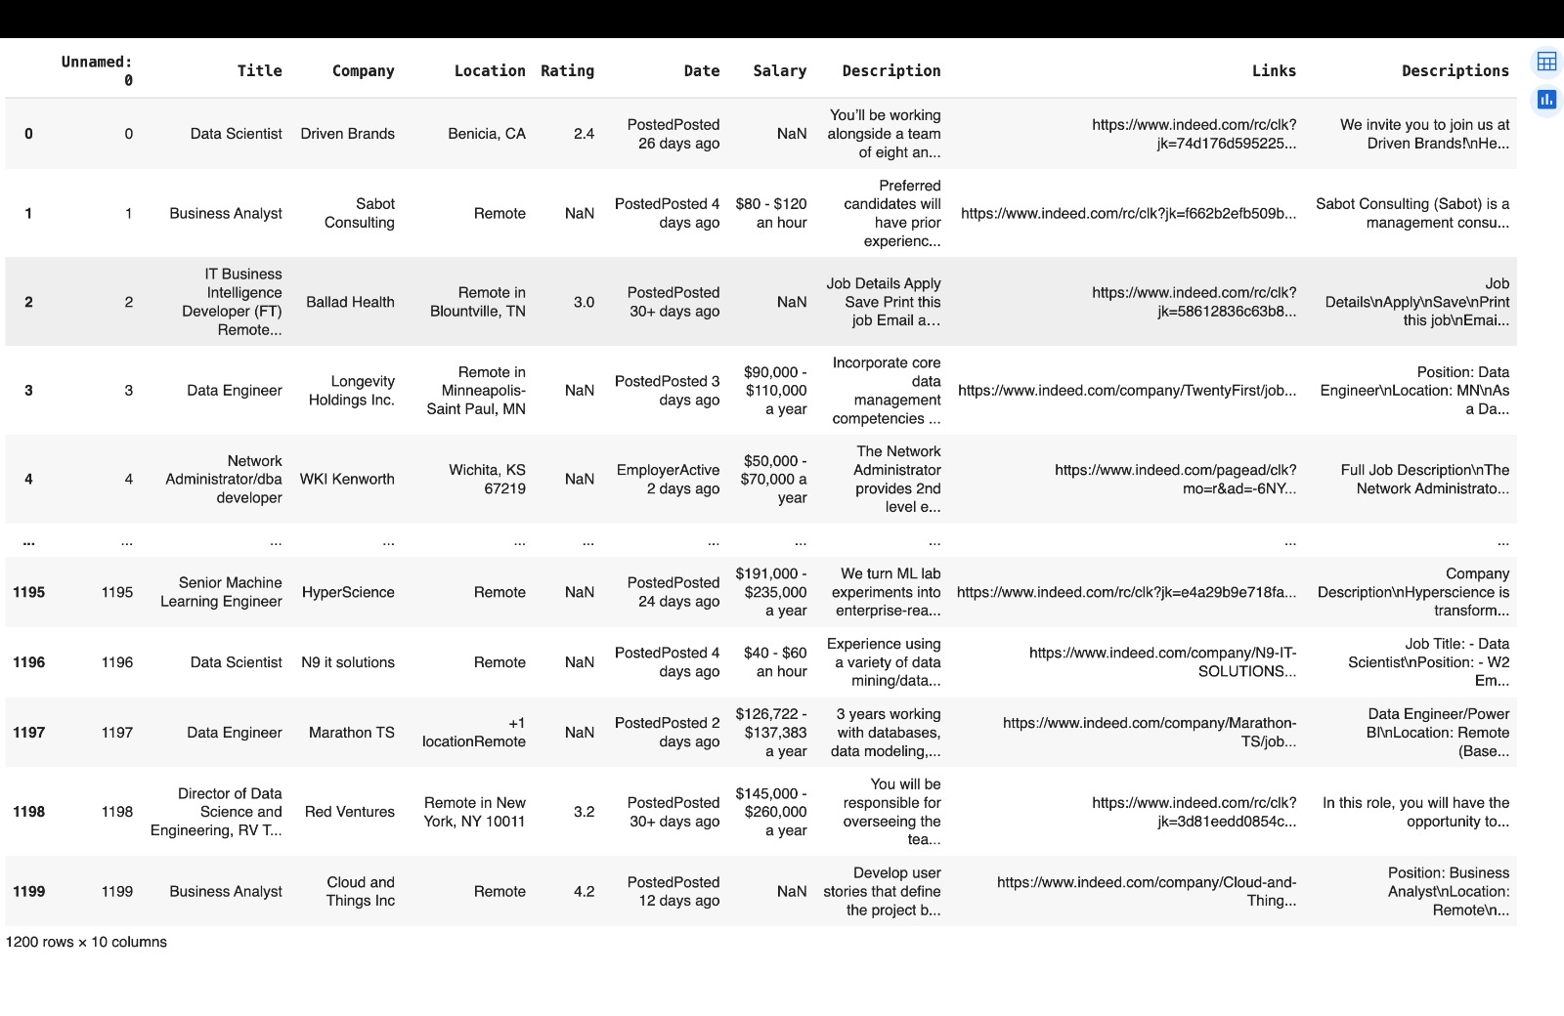
Dataset
Source: Indeed, which is among the most popular job portals on the internet, is where we obtained our data. There are a huge number of job postings offered. Data Collection: This data was meticulously web scraped via the Indeed web portal , using the Indeed API. This approach guarantee that our data set is accurate and up-to-date when compared to the job marketplace. Key Features: Essential features like Job Titles, Locations, as well as Company Ratings are all included in the dataset. These factors are critical to our analysis. Purpose: The primary objective of this data set is to analyze trends in jobs ads. We hope that by analyzing this data, we can help HR departments make better decisions based on information and improve the quality of their hiring processes.

Slide 4
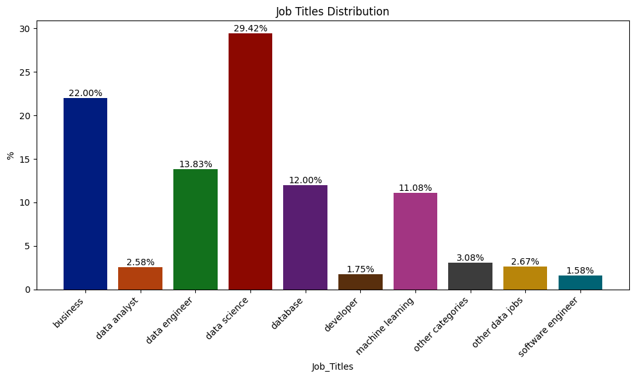
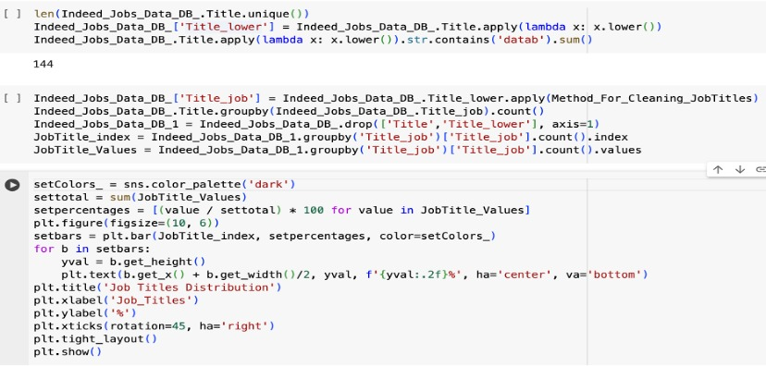
Data Analysis - Job Titles Distribution
According to our findings, "Data Science" is the most popular job role in the dataset, accounting for 29.42% of postings. This highlights the significant need for data science experts in the job marketplace.
In addition to Data Scientists, the industry has an insatiable demand for data-centric jobs such as Data Analysts and Data Engineers.
The dataset supports the idea that businesses are increasingly looking to fill data-centric positions. Data scientists and analysts have grown increasingly important to the success of companies.

Slide 5
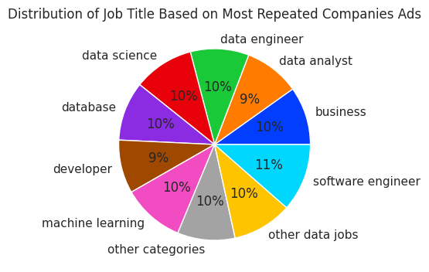
Data Analysis - Most Repeated Companies' Ads
Our research shows that positions in the fields of Data Science, Data Engineering, and Software Engineering are always in high demand. These jobs represent the most sought-after specializations by companies.
We see that businesses are expanding their job boundaries to include a wider range of data-related roles. They have realized the value of data in many areas of their business, and their strategy reflects it.
The dataset reveals a significant change in how businesses deploy their employees in their HR departments. They are hiring for positions involving both the management and utilization of data, such as Data Scientists and Software Developers. This demonstrates an all-encompassing strategy for utilizing data in working environments.

Slide 6
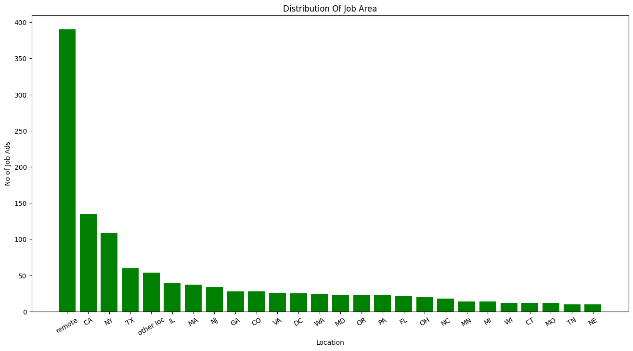
Data Analysis - Job Area Distribution
Our analysis finds that the most popular jobs location in this group is "Remote," showing an increasing trend to possibilities for remote employment. This connects with the worldwide shift to flexible work arrangements.
Particularly, powerful tech businesses may be found in both California and New York, both of which are major employment hubs for data-related jobs. Careers in this industry can be found in a variety of states, with Texas, Illinois, among Massachusetts emerging as key locations.

Slide 7
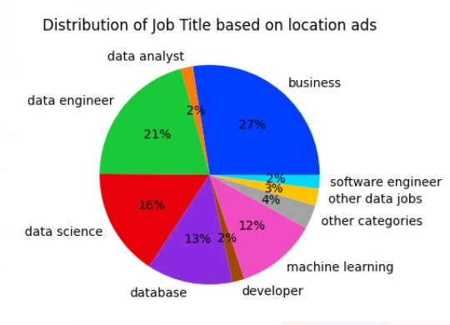
Data Analysis - Job Title based on Location
The distribution of job titles by location is shown in the graphic, which highlights the importance of business and data-centric careers in the modern workforce.
At 27%, the "Business" title dominates and denotes a flourishing corporate ecosystem in particular areas.
Data experts are in high demand, as seen by the significant prevalence of "Data Engineer" and "Data Science" professions (21% and 16%, respectively), which highlights the changing nature of the labor market and its strong preference for data-driven skills and knowledge.

Slide 8
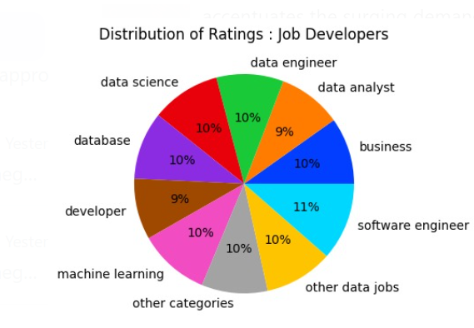
Data Analysis - Distribution of Ratings : Job Developers
The pie chart displaying the distribution of evaluations for job developers across varied titles indicates a good equilibrium. Each section marking a spread of around 9-11% expresses an overarching satisfaction or uniform performance review across the board, independent of the specific domain. This fair rating shows a constant quality of work and professionalism by job developers in diverse professions.

Slide 9
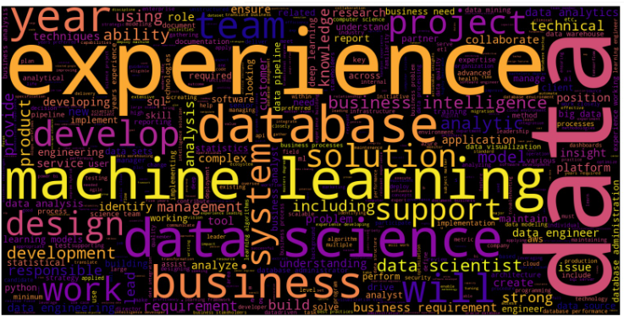
Data Analysis - Most Repeated Words:
Regarding data analysis, the word cloud highlights the present industrial zeitgeist since it is filled with frequently occurring terms from job descriptions.
The prevalence of words such as "data", "experience", "business", "analysis", "learning", and "database" suggests a clear desire for experts in these fields, explaining the current and possibly growing need for such knowledge in the labor market.

Slide 10
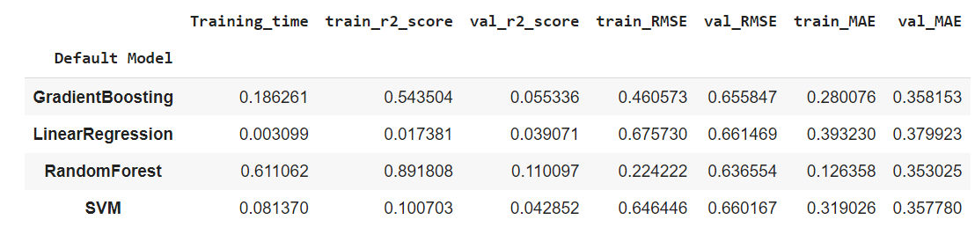
Model Evaluation and Results:
A promising model on the list, Random Forest has a strong R2 score and comparatively low RMSE and MAE values.

Slide 11
Conclusion and Future Recommendations:
Based on the data, it appears that the RandomForest model has the greatest balanced performance metrics. With its high accuracy and low error, it is suitable for making forecasts. Overfitting must be taken into account, though, particularly with models like linear regression that produced flawless ratings. One of the recommendations for the future is to further optimize the RandomForest model by performing extensive hyperparameter tuning. To find out if the prediction accuracy can be improved, it would also be advantageous to investigate neural network topologies and ensemble approaches. Models may be kept accurate and relevant over time by periodically updating their data and retraining them.

Slide 12
Thank you

